Slide 1
Conference Summary AXRO 24

Slide 3
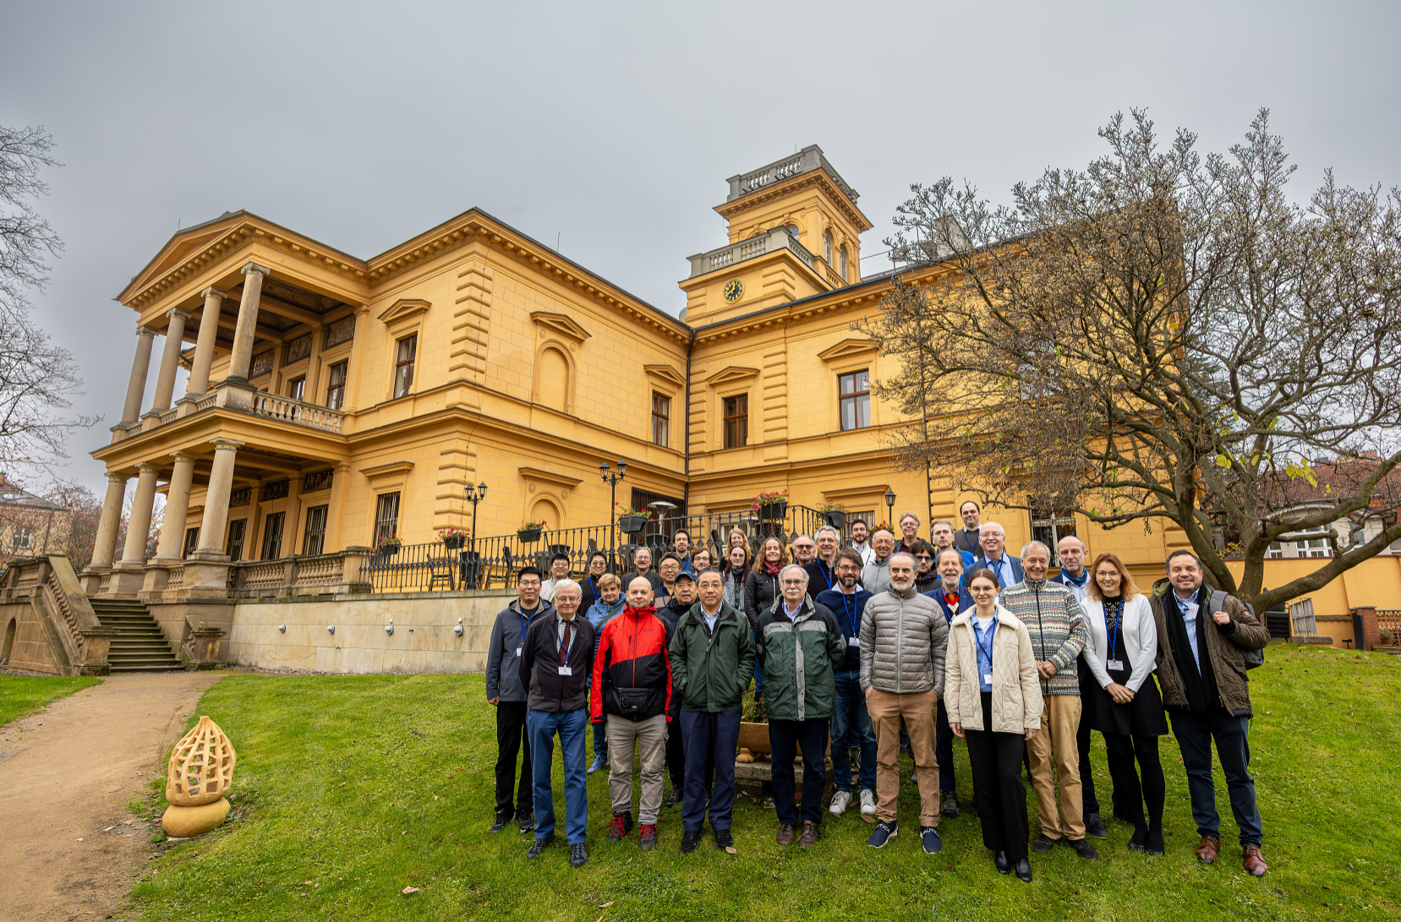
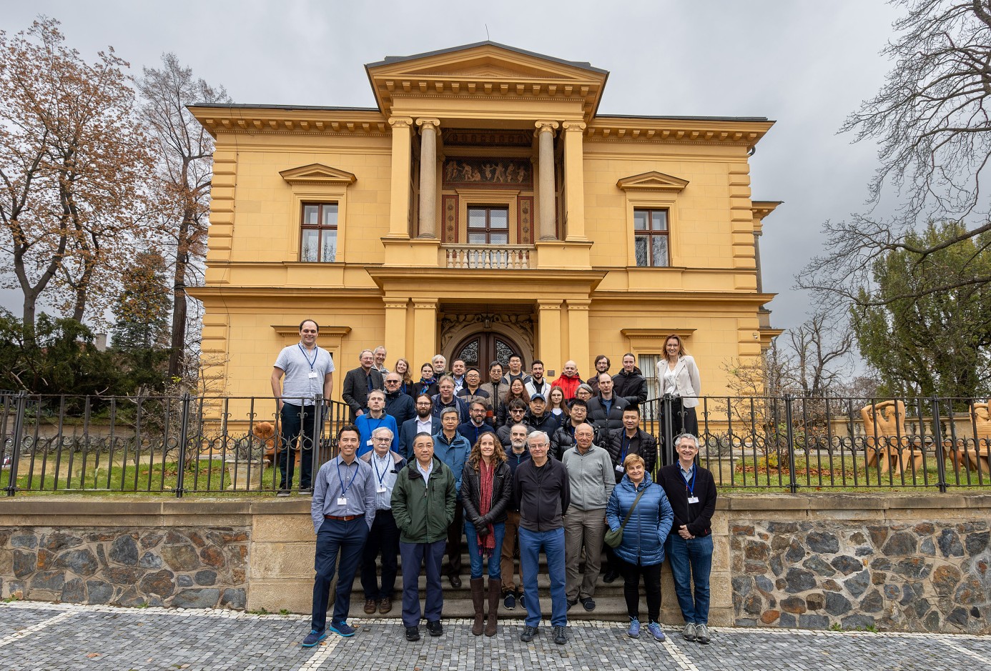

Slide 13
A big thank you to the hosts
for a very well organised meeting
And looking forward to the
AXRO 25 meeting

